Slide 1
William Stallings
Computer Organization and Architecture
Chapter 9
Computer Arithmetic

Slide 2
Key Points
Two principle concerns for computer arithmetic
      the way in which numbers are represented
      the algorithms used for the basic arithmetic operations
These two considerations apply both to integer and floating point arithmetic

Slide 3
Arithmetic & Logic Unit (ALU)
part of the computer that actually performs arithmetic and logical operations on data.
Handles integers
May handle floating point (real) numbers

Slide 4
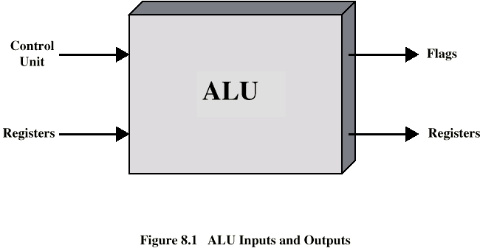
ALU Inputs and Outputs

Slide 5
Integer Representation
Only have 0 & 1 to represent everything
Positive numbers stored in binary
  e.g. 41=00101001
No minus sign
No period
Sign-Magnitude
Two’s complement

Slide 6
Sign-Magnitude
Left most bit is sign bit
0 means positive
1 means negative
+18 = 00010010
-18 = 10010010
Problems
  Need to consider both sign and magnitude in arithmetic
  Two representations of zero (+0 and -0)

Slide 7
Two’s Complement
+3 = 00000011
+2 = 00000010
+1 = 00000001
+0 = 00000000
-1 = 11111111
-2 = 11111110
-3 = 11111101

Slide 8
Benefits of 2’s complement
One representation of zero
Arithmetic works easily (see later)
Negating is fairly easy
  3 = 00000011
  Boolean complement gives 11111100
  Add 1 to LSB 11111101

Slide 9
Geometric Depiction of Twos Complement Integers

Slide 10
Negation Special Case 1
0 = 00000000
Bitwise not 11111111
Add 1 to LSB +1
Result 1 00000000
Overflow is ignored, so:
- 0 = 0 √

Slide 11
Negation Special Case 2
-128 = 10000000
bitwise not 01111111
Add 1 to LSB +1
Result 10000000
So:
-(-128) = -128 X
Monitor MSB (sign bit)
It should change during negation

Slide 12
Range of Numbers
8 bit 2’s complement
  +127 = 01111111 = 2 -1
  -128 = 10000000 = -2
16 bit 2’s complement
  +32767 = 011111111 11111111 = 2 - 1
  -32768 = 100000000 00000000 = - 2

Slide 13
Conversion Between Lengths
Positive number pack with leading zeros
+18 = 00010010(sign magnitude, 8bits)
+18 = 00000000 00010010(sign magnitude,16bits)
Negative numbers pack with leading ones
-18 = 10010010(sign magnitude, 8bits)
-18 = 10000000 10010010(sign magnitude,16bits)
i.e. pack with MSB (sign bit)

Slide 14
Addition and Subtraction
Normal binary addition
Monitor sign bit for overflow
Take twos complement of subtrahend and add to minuend
  i.e. a - b = a + (-b)
So we only need addition and complement circuits

Slide 15
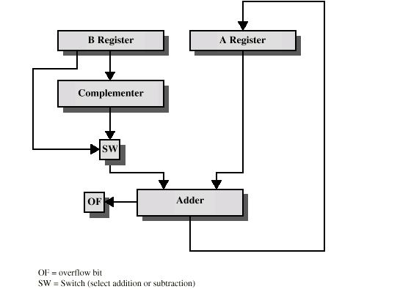
Hardware for Addition and Subtraction

Slide 16
Multiplication
Complex
Work out partial product for each digit
Take care with place value (column)
Add partial products

Slide 17
Multiplication Example
1011 Multiplicand (11 dec)
x 1101 Multiplier (13 dec)
1011 Partial products
0000
1011
1011
10001111 Product (143 dec)
Note: need double length result
if multiplier bit is 1 copy
otherwise zero

Slide 18
Unsigned Binary Multiplication

Slide 19
Execution of Example

Slide 20
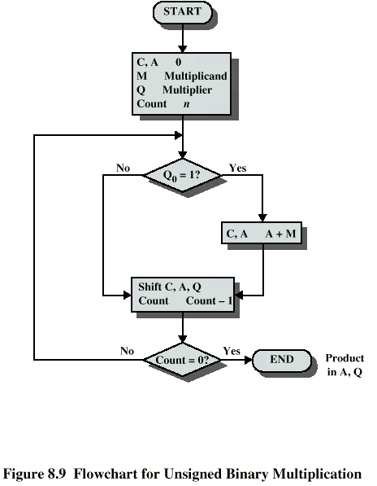
Flowchart for Unsigned Binary Multiplication

Slide 21
Multiplying Negative Numbers
Solution 1
Convert to positive if required
  Multiply as above
  If signs were different, negate answer
Solution 2
  Booth’s algorithm

Slide 22
Division
More complex than multiplication
Negative numbers are really bad!
Based on long division

Slide 23
Division of Unsigned Binary Integers
ASSIGNMENT
Multiplying Negative Numbers
(Booth’s algorithm)

